Slide 1
Creative foam

Slide 2
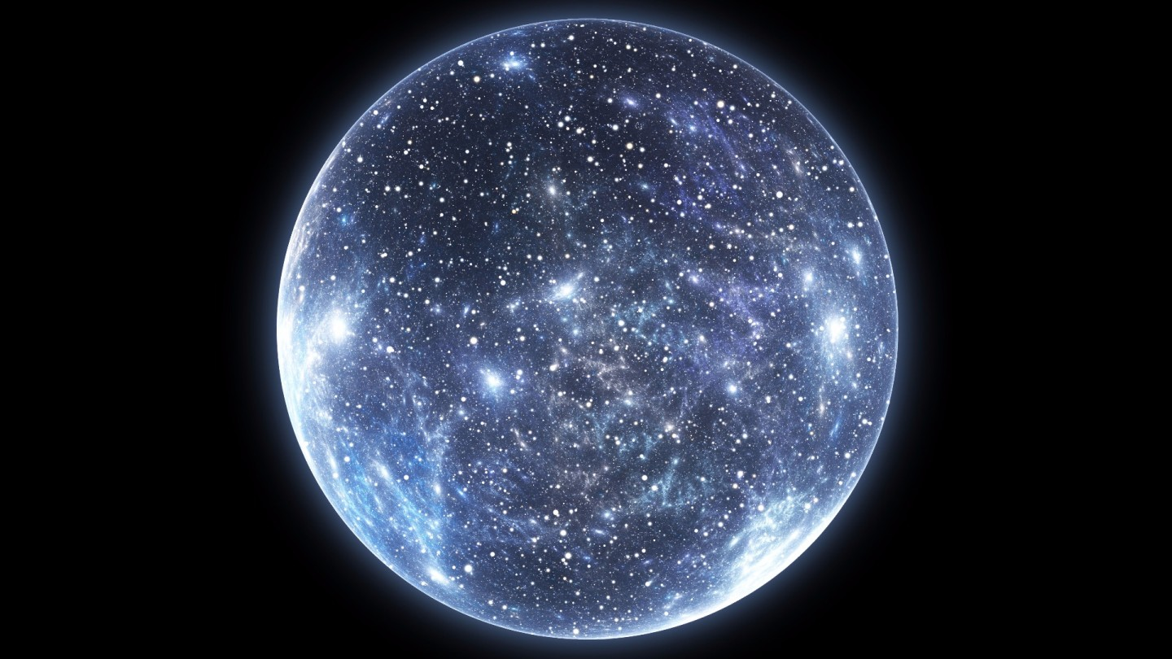

Slide 3
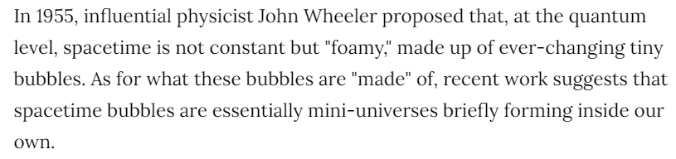
Inspiration
I like the theory that the reason our universe exists is because a large bubble of existence happened to appear, and is passing through time just like a ‘game of life’ simulation. The heat death of the universe is like when all that’s left is static shapes and those 3x1 flip-floppers.

Slide 4
Goal:
To make the game of life simulation more accurate to this theory which includes spontaneous appearance/disappearance, and make it more beautiful because I find the idea very satisfying and beautiful.

Slide 5
Modifications to the game
Functional:
Cells have a tiny chance to become the opposite of the state they should be, if near alive cells
Visual:
Pretty colors
Gradation through blurring
Panning effect to give the illusion that it’s constantly expanding
Audio:
A song, volume modified by the average intensity of the simulation

Slide 6
Result
Touch designer is complicated, and so is getting the game of life to do what you want. The result isn’t as neat as I’d hoped for, some features had to be cut, and there are bugs such as the noise speed being independent of generations.
I did learn a lot about touch designer though, and I enjoy the final color palette which resembles leaves with light shining through.

Slide 7
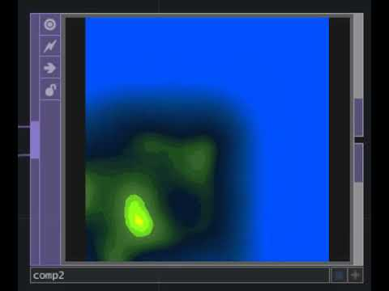
Result

Slide 8
https://github.com/AndrewDunne/CMPM169Projects

Slide 9
Bibliography
https://www.vice.com/en/article/j5yngp/the-universe-is-made-of-tiny-bubbles-containing-mini-universes-scientists-say
https://stackoverflow.com/questions/4200224/random-noise-functions-for-glsl

Slide 10
Other research
http://www.bbc.com/earth/story/20141106-why-does-anything-exist-at-all
https://www.sciencedirect.com/science/article/pii/S221268641300037X

